Slide 2






$$δ$$
$$a$$
$$b$$
$$R$$
$$R_{1}$$

Slide 3









$$α_{f}$$
$$δ$$
$$β$$
$$a$$
$$V$$
$$R$$
$$γ$$
$$α_{R}$$
$$b$$

Slide 4


Direction of Motion
$$α$$
$$F_{y}$$

Slide 5




















$$F_{y,RL}$$
$$F_{y,FL}$$
$$F_{x,FL}$$
$$δ_{FL}$$
$$F_{x,RL}$$
$$M_{TA,FL}$$
$$M_{TA,RL}$$
$$y$$
$$x$$
$$C_{F}$$
$$C_{R}$$
$$F_{y,FR}$$
$$F_{y,RR}$$
$$F_{x,FR}$$
$$M_{TA,FR}$$
$$δ_{FR}$$
$$M_{TA,RR}$$
$$F_{x,RR}$$
$$b$$
$$a$$

Slide 6
Under Steer
Neutral Steer
Over Steer

Slide 7






$$y_{t}$$
$$C_{t−1}$$
$$C_{t}$$
Forget Gate
Input Gate
Output Gate
tanh
$$h_{t}$$
sigmoid
sigmoid
tanh
sigmoid
$$h_{t−1}$$
$$x_{t}$$

Slide 8







$$acc$$
$$friction circle$$
$$acc$$
$$left turn$$
$$right turn$$
$$conering$$
$$brake$$

Slide 9



$$x_{2}$$
$$x_{1}$$
$$S\left(x\right)=0$$

Slide 10




$$Lateral Force$$
$$Linear$$
$$Transitional$$
$$Side Angle$$

Slide 11
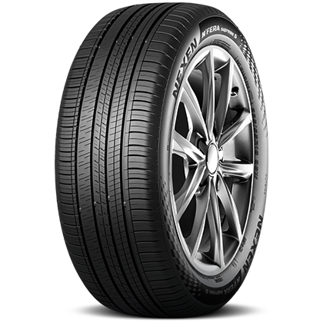


$$F_{y}$$
$$F_{x}$$

Slide 12
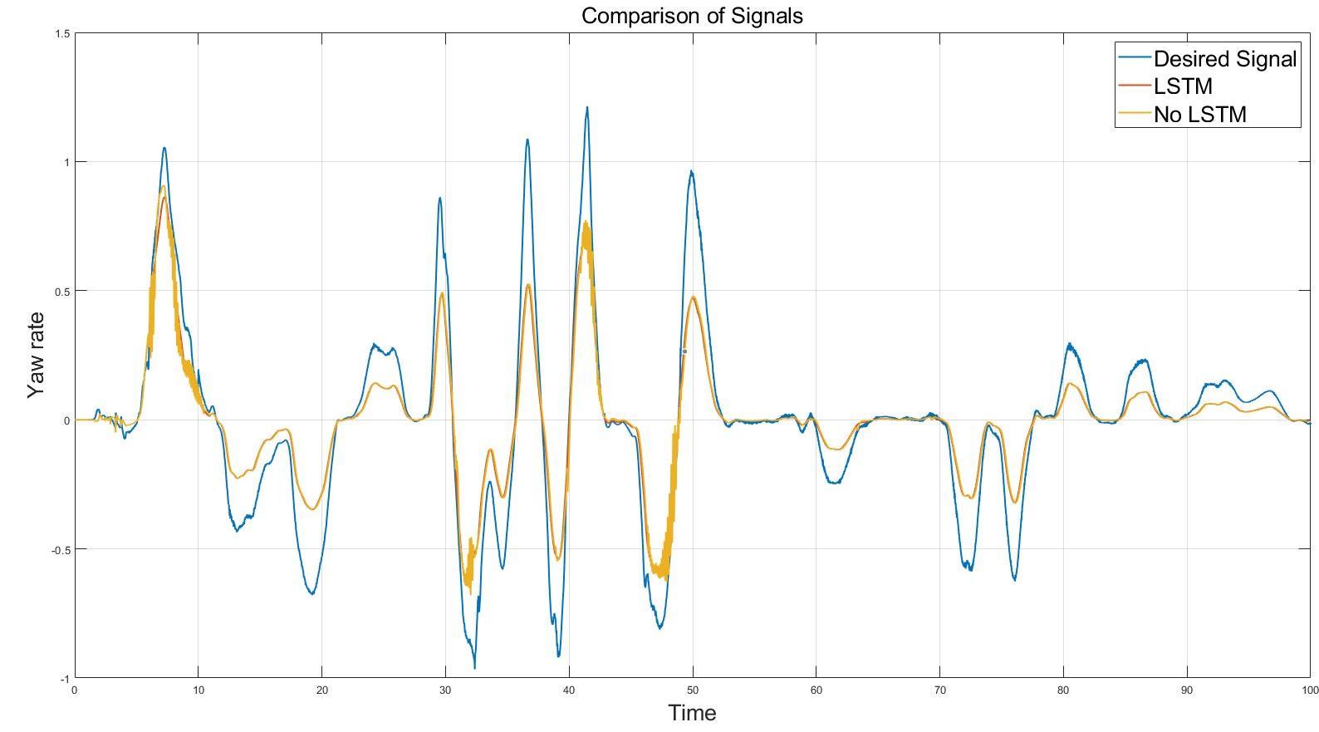
①
②

Slide 13
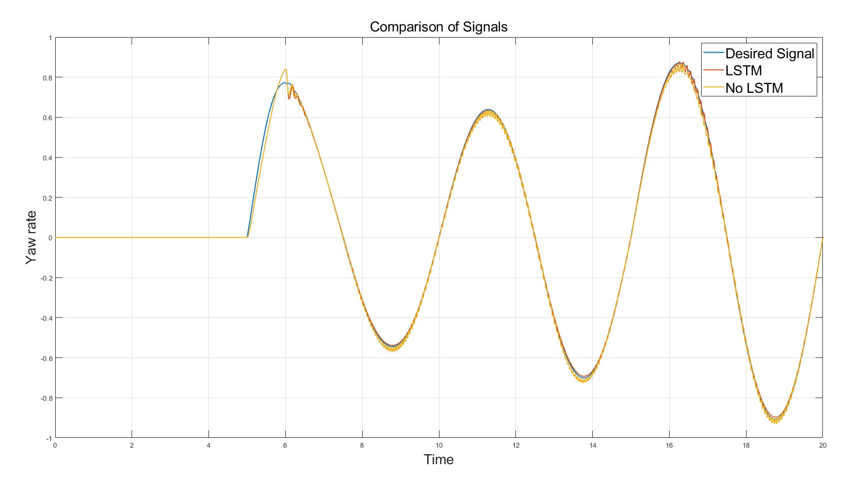
①

